Slide 1
Initial Coin Offerings & Token Sale Events, Trading & Speculation
SoftUni Team
Technical Trainers
Software University
http://softuni.bg

Slide 2

Table of Contents
Homework & Questions
Initial Coin Offerings
Trading & Speculation
Portfolio Management & Rules

Slide 3
Questions
sli.do #B-Chain-Intro

Slide 4
Homework Test (Lecture 5)
What is the difference between an ASIC miner and a GPU?
Which of the options below is capable of computing SHA-256?
Which is fastest at computing an Equihash algorithm equation?
Which cryptocurrency uses the Equihash algorithm?
What algorithm used to mine Ripple?
Verification transactions with Proof of Work consensus are done by who?
What kind of hardware is used for PoW mining of Ethereum?

Slide 5
Homework Test (Lecture 6)
What does the Gas represent in the Ethereum blockchain?
What information does a block header include?
Which of the following qualities are true about the Ethereum blockchain technology and its global node network?
Which of the following characteristics are valid for the Ethereum blockchain when we refer to it as “fault tolerant”?

Slide 6
Homework Test (Lecture 6)
Which of the following are possible properties of an Ethereum transaction?
Which of the following are true for Smart Contracts deployed on the Ethereum Blockchain?
Which of the following are true challenges that enterprises face when planning a solution on Ethereum?

Slide 7
Bitcoin Lightning Network & Channels
A system of smart contracts that allow transactions to take place off the main Bitcoin chain.
Main wallet based on a smart contract that defines how much funds each party has.
Parties conduct unlimited amount of transactions without ever touching the information on the blockchain.
The updated balance sheet is kept by all parties, not in the blockchain. Once the channel is closed, the transaction is recorded in the blockchain.
All channels are public, meaning that I can monitor any channel.

Slide 8
Questions?

Slide 9
Disclaimer
Do not take this session as financial advice
I am not a financial advisor
Do your own research if you plan to invest
The ICO & trading markets are extremely risky
Always be prepared to lose ALL of your money in ICO’s and Crypto-currencies

Slide 10
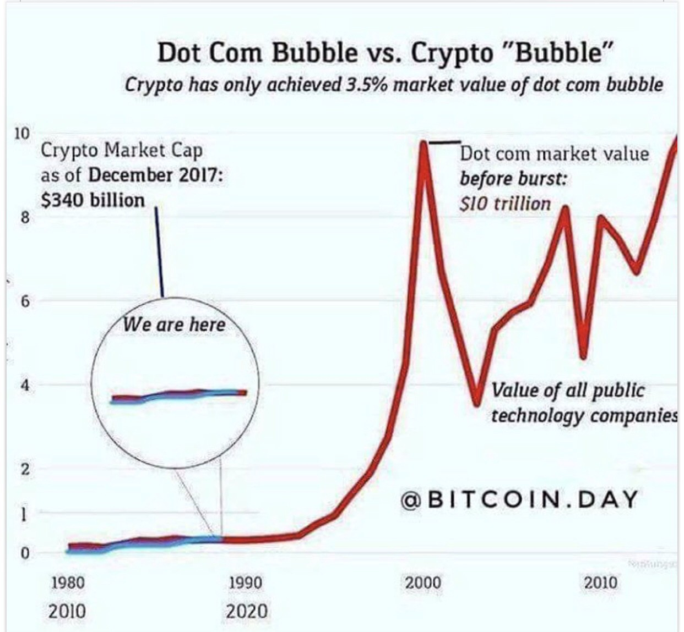

Slide 11
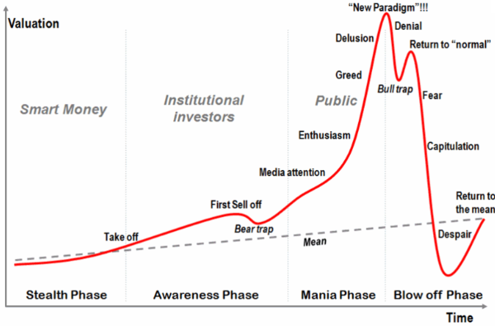
Notes:
Bitcoin leads the bull rally.
Bitcoin reaches new all time high.
Bitcoin’s price somewhat “stabilizes”
A handful of solid altcoins rally behind Bitcoin, ETH & LTC leading the altcoins this time.
Top altcoins “somewhat” stabilizes, also reaching new all time high.
Majority of cryptocurrencies follow.
Majority of crypto including Bitcoin and top altcoins price stabilize.
HUGE Correction starts
Crypto depression
Back to step 1, rinse and repeat.

Slide 12
Initial Coin Offerings
The new vehicle for fund-raising

Slide 13
Initial Coin Offerings
An alternative to IPO’s
ICOs aim to raise “value”
Release/issue tokens for another asset or currency
Executed on a blockchain
Designed to crowdfund project investment
Wider reach to investors (which may become users!)
Not a VC/Accelerator target model
Easy to collect “value” in the form of crypto or fiat
Usually facilitated by an ICO platform

Slide 14
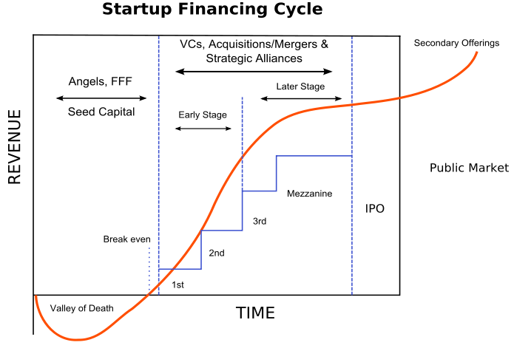
Traditional Financing Cycle

Slide 15
IPO’s vs ICO’s
ICO
IPO
Regulation
Credibility
Rewards
Duration
Access
Not a lot
Weak
Growth
Short
Open
Very regulated
Strong history
Dividends
Long-term
Sometimes exclusive

Slide 16
Token Economy
You define your own economic model and incentive scheme
Duration
Discount
Rounds
Capped vs Uncapped
Generation logic & returns on failure

Slide 17
Profile
Skilled blockchain experts
Project believers
Informed investors
Investors with very little experience

Slide 18
Utility Token vs Security Token
Security Token
“Shares” in a business
Regulated by SEC in the US
Avoided now
Utility Token
Future access to a product or service, not ownership in a business
Used as “currency” to trade for something else
Filecoin, LockChain

Slide 19
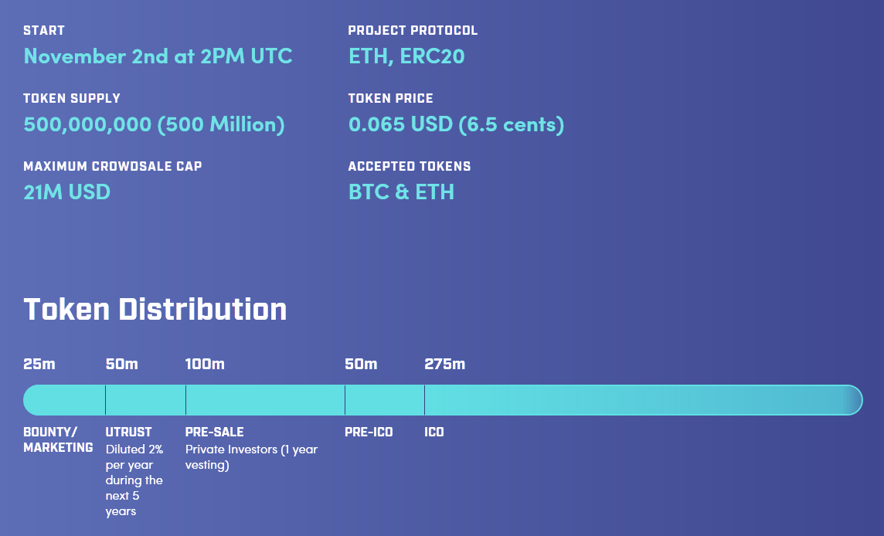

Slide 20
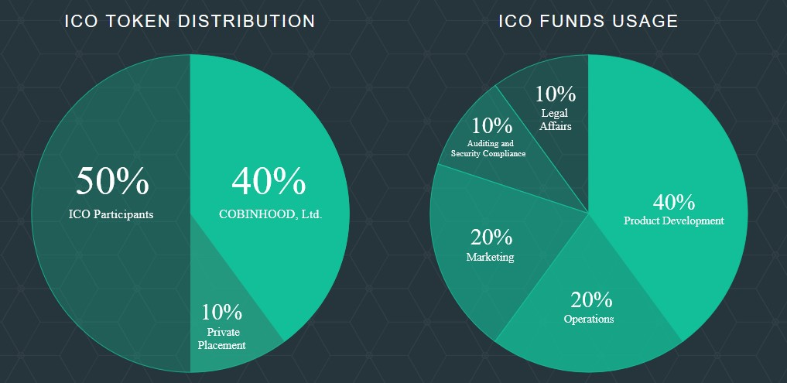

Slide 21
ICO Platforms
Ethereum with Smart Contracts
https://coinlaunch.co
https://blockstarter.co/
Indiegogo
https://coinlist.co/

Slide 22
Sourcing ICOs
Search/Ads
e.g.
Facebook Google ICO Listings
Forums
e.g.
BitcoinTalk Reddit Steemit 4chan
Paid Reports
e.g.
Cliff High Palm Beach
YouTube
e.g.
Cliff High Ian Balina Slivertooth
Messaging
e.g.
Telegram Slack WeChat

Slide 23
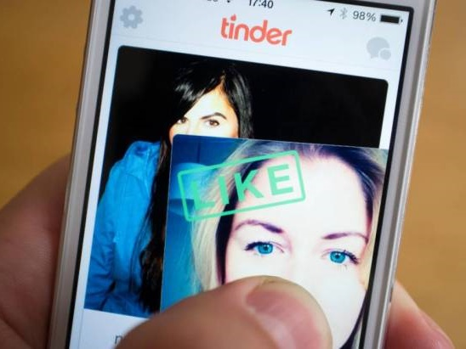
Initial Research
Team Members & Advisors
Soft & Hard Capitalization
New Blockchain or Not
Hype Factor
Timing
Red Flags / Scam / Ponzi Scheme

Slide 24

In-Depth Research
Token Distribution & Transfer
Exchange Listing
Whitepaper Review
Roadmap Review
Media Coverage
Personal Contact with Team

Slide 25

Decision Making
Does Something Bother You?
Do You Have Better Options?
Does Investing Make Sense?
Are You Entering on Good Terms?
How Long Can/Will You HODL?

Slide 26

Investing
Reading Smart Contracts
Multiple Transactions
Writing a Smart Contract
Running your Own Node
Pre-Generating Transactions
Network Load & When to Send
DDoS Attacks

Slide 27

HODLing
Market Overview
Sentiment Analysis
Exchange Listing
News & Announcements
Events & Milestones
www.coinmarketcal.com

Slide 28

Exiting
Opportunity Cost
Exit Timing
Amount of Funds to Exit
Where to Exit
How to Exit

Slide 29
Whitepaper Examples
https://www.monetha.io/Monetha_WP.pdf
https://www.aeternity.com/aeternity-blockchain-whitepaper.pdf
https://github.com/ethereum/wiki/wiki/White-Paper
https://coss.io/documents/white-papers/iconomi.pdf
https://www.cryptokitties.co/Technical-details

Slide 30
Legislation & Regulation
Very different from country to country
Governments are still trying to figure it out
Securities and Exchange Commission on violations of law
https://www.sec.gov/litigation/investreport/34-81207.pdf
Appealing countries: Bulgaria, Singapore, Estonia, Liechtenstein, Switzerland
Get a good legal team and listen to them
They must be knowledgeable about cryptomarkets and company law

Slide 31
Trading & Speculation
Making money out of cryptocurrencies

Slide 32

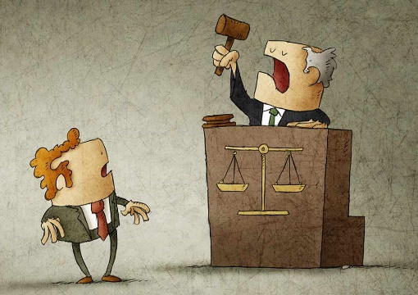

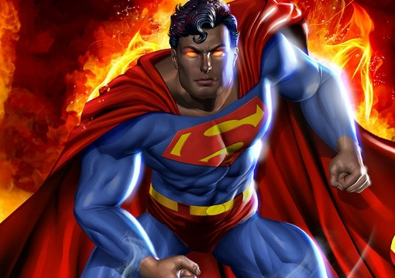
Trading on Events
Sourcing
e.g.
CoinMarketCal.com CryptoCalendar.pro Reddit.com Steemit.com Telegram/Slack/etc.
Evaluation
e.g.
Market Sentiment Short- vs. Long-Term Effect on Price Liquidity Exposure
Timing
e.g.
Buy the Rumor, Sell the News Stick to Your Targets
Execution
e.g.
Technical Analysis Stop-Loss vs. Trailing Stop-Loss

Slide 33
Trading on Margin
Pros:
Increases profit potential
Gives you the flexibility to take advantage of short- term opportunities
Is often tax-deductible against your investment income
Cons:
Increases loss potential
Very sensitive to day-to-day market moves
You can lose more funds than you have in your account

Slide 34
Technical Analysis Trading
Price fluctuation & behavior
Changes in trading volume
Rumors, news, announcements
Monitoring the order book
Acting on signals
Manipulating markets
www.tradingview.com

Slide 35
Automated & Algorithmic Trading
Arbitrages between exchanges
Arbitrages between three pairs on one exchange
Signal subscription
Signal generation

Slide 36
Portfolio Management & Rules

Slide 37
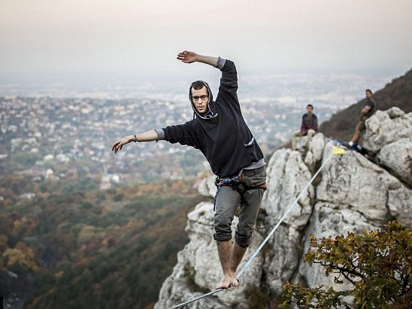
Choosing the Right Portfolio
Define your targets and stick to them
Do not act emotionally
3-5 investments at a time
Monitor and act/adjust quickly
Anticipate the future and prepare for the worst

Slide 38
Personal Rules
I never invest money I can’t afford to lose
I don’t panic
I don’t short
I don’t margin trade
I don’t invest in things I don’t believe in or agree with
I don’t chase the market
I am careful with the advice of others
For each trade have a target entry and exit price
I do not ever operate with stop losses

Slide 39
Resources & Links

Slide 40
Interesting Telegram Channels
SmartContracts — channel with news about blockchain and ICO
Thecointelegraph — the official channel about Cointelegraph media about Fintech, Blockchain and Bitcoin
Preicoved — listing of Pre-ICO and Pre-sale crypto projects
ICO, Blockchain, Startups — group of investors, experts and entrepreneurs, discussing the regulatory issues, insightful news and trends of blockchain and crypto market and analysing ICO startups.
Cryptocurrency — telegram channel posting news about cryptocurrencies (mostly from Cointelegraph) and upcoming ICOs (rarely)
CryptoCommunities — listing of global crypto communities in telegram
Bitnationchat — Telegram presence of the Bitnation community

Slide 41
Reddit Subreddits
BlockChain — all the stuff about blockchain
Blockchain Startups — dedicated subreddit for blockchain startups
CryptoCurrency — all subjects related to emerging crypto-currencies and crypto-assets
Icocrypto — the place to come for discussion of everything related to active and upcoming ICO / Crowdsales
ethtrader — Ethereum news, memes, investing, trading, miscellaneous market-related subjects and other relevant technology.
ICOAnalysis — a place to analyse cryptocurrency ICO companies.
CryptoICO — ICO listings, information and discussions
InitialCoinOfferings — discussions related to ICO, Crowdsales and Token sales in the fields of Blockchain and Datachain
Best of Crypto — this subreddit is for sharing and archiving the best comments regarding cryptocurrency within Reddit
IcoCrypto — Discussions related to ICO, Crowdsales and Token sales in the fields of Blockchain and Datachain

Slide 45





Trainings @ Software University (SoftUni)
Software University – High-Quality Education, Profession and Job for Software Developers
softuni.bg
Software University Foundation
http://softuni.foundation/
Software University @ Facebook
facebook.com/SoftwareUniversity
Software University Forums
forum.softuni.bg

